Slide 1

IILM UNIVERSITY
Greater Noida, Uttar Pradesh
Full-Stack Web Development and
AI/ML Model Research & Training
at ILPedia.com
Summer Internship Presentation
STUDENT NAME
ENROLLMENT / ROLL NO.
PROGRAM & SEMESTER
SECTION
ORGANIZATION
Umar Iqbal
2410030933
B.Tech CSE (Data Science & Big Data Analytics) — 5th Semester
3CSE12
ILPedia.com

Slide 2



Internship Overview
A two-month Summer Internship at ILPedia.com, combining hands-on full-stack software development with research-oriented work in Artificial Intelligence and Machine Learning.
AT A GLANCE
2
Months of hands-on internship
DURATION
28 May – 28 July 2026 (2 Months)
2
Core tracks: Full-Stack + AI/ML
ROLE
12
Full Stack Developer with AI/ML Model Researcher & ML Model Trainer
Key responsibility areas
3
Official documents of completion
ORGANIZATION
ILPedia.com — “Your Gateway to the World of Ionic Liquids”
ILPedia.com Internship | Umar Iqbal
2

Slide 3
ILPedia.com is a knowledge and technology-driven organization focused on building and disseminating research-oriented digital resources in the domain of ionic liquids and related chemical sciences.
Alongside this core knowledge platform, the organization undertakes technology-driven initiatives spanning full-stack web development, Artificial Intelligence, and Machine Learning — applying modern computational tools to research, data analysis, and digital platform development.
Organization
Profile
LEADERSHIP
ILPedia.com
Dr. Mohammad Tariq
“Your Gateway to the World of Ionic Liquids”
Mentors interns with hands-on exposure to both software development and AI/ML research workflows, emphasizing academic rigor blended with applied engineering.
contact@ilpedia.com
3

Slide 4






Roles & Responsibilities
Appointed as Full Stack Developer with AI/ML Model Researcher & ML Model Trainer
Full-Stack Development
Data Handling
ML Model Training
Developing, testing, and integrating frontend and backend web application features.
Collecting, cleaning, and preprocessing datasets for machine learning applications.
Training, evaluating, testing, and optimizing machine learning models.
Experimentation
Debugging & QA
Collaboration
Comparing algorithms and approaches through structured model experimentation.
Debugging, troubleshooting, and improving applications and trained models.
Working with the team, following timelines, and maintaining technical documentation.
ILPedia.com Internship | Umar Iqbal
4

Slide 5

Project Objectives
1
Gain hands-on experience in full-stack web development — frontend, backend, testing, and integration.
2
Conduct research on AI/ML models, techniques, and real-world applications.
3
Assist in dataset collection, cleaning, and preprocessing for machine learning tasks.
4
Train, evaluate, and optimize ML models, comparing algorithms and approaches.
5
Implement and integrate AI/ML models into practical, usable software applications.
6
Strengthen debugging, teamwork, and technical documentation skills through real projects.
5

Slide 6
Scope of the Project
Development Track
Research & ML Track
Designing, building, and maintaining full-stack web applications.
Dataset preparation, model experimentation, and evaluation.
Frontend user-interface development and backend service logic.
Optimization and integration of trained models into applications.
Integration of frontend and backend components and testing.
Documentation of research findings, experiments, and progress.
ILPedia.com Internship | Umar Iqbal
6

Slide 7

Technologies & Tools Used
Frontend
Backend
Databases
HTML5, CSS3, JavaScript & modern UI frameworks
Server-side frameworks & RESTful API design
Relational & NoSQL data storage
ML / AI
Version Control
Dev Tools
Python-based ML libraries for training & evaluation
Git & GitHub for collaborative development
Code editors, debuggers & testing utilities
ILPedia.com Internship | Umar Iqbal
7

Slide 8
System Architecture
A layered approach separating application development from ML research
Presentation Layer
Frontend interface through which users interact with the application.
Application / Backend Layer
Server-side logic handling requests, business rules, and communication.
Data Layer
Databases and datasets for application data and ML training/evaluation.
ML / AI Layer
Trained models performing predictions and AI-driven tasks in the backend.
8

Slide 9
Methodology
Iterative, agile-aligned workflow followed for both development and ML tasks
1
2
3
4
5
Requirement
Understanding
Design &
Data Prep
Implementation /
Model Training
Testing &
Evaluation
Integration &
Optimization
For ML tasks, this follows the standard pipeline: data collection & preprocessing → exploratory analysis → model selection → training → evaluation → iterative optimization.
ILPedia.com Internship | Umar Iqbal
9

Slide 10

Outcomes & Key Learnings
Practical, working knowledge of full-stack web development end to end.
Hands-on experience preparing datasets and training/evaluating ML models.
1
2
Improved ability to research and apply AI/ML techniques to real problems.
Strengthened debugging, testing, and software engineering skills.
3
4
Enhanced teamwork, documentation, and timeline-driven professionalism.
Successful completion, formally recognized by ILPedia.com's certification.
5
6
10

Slide 11
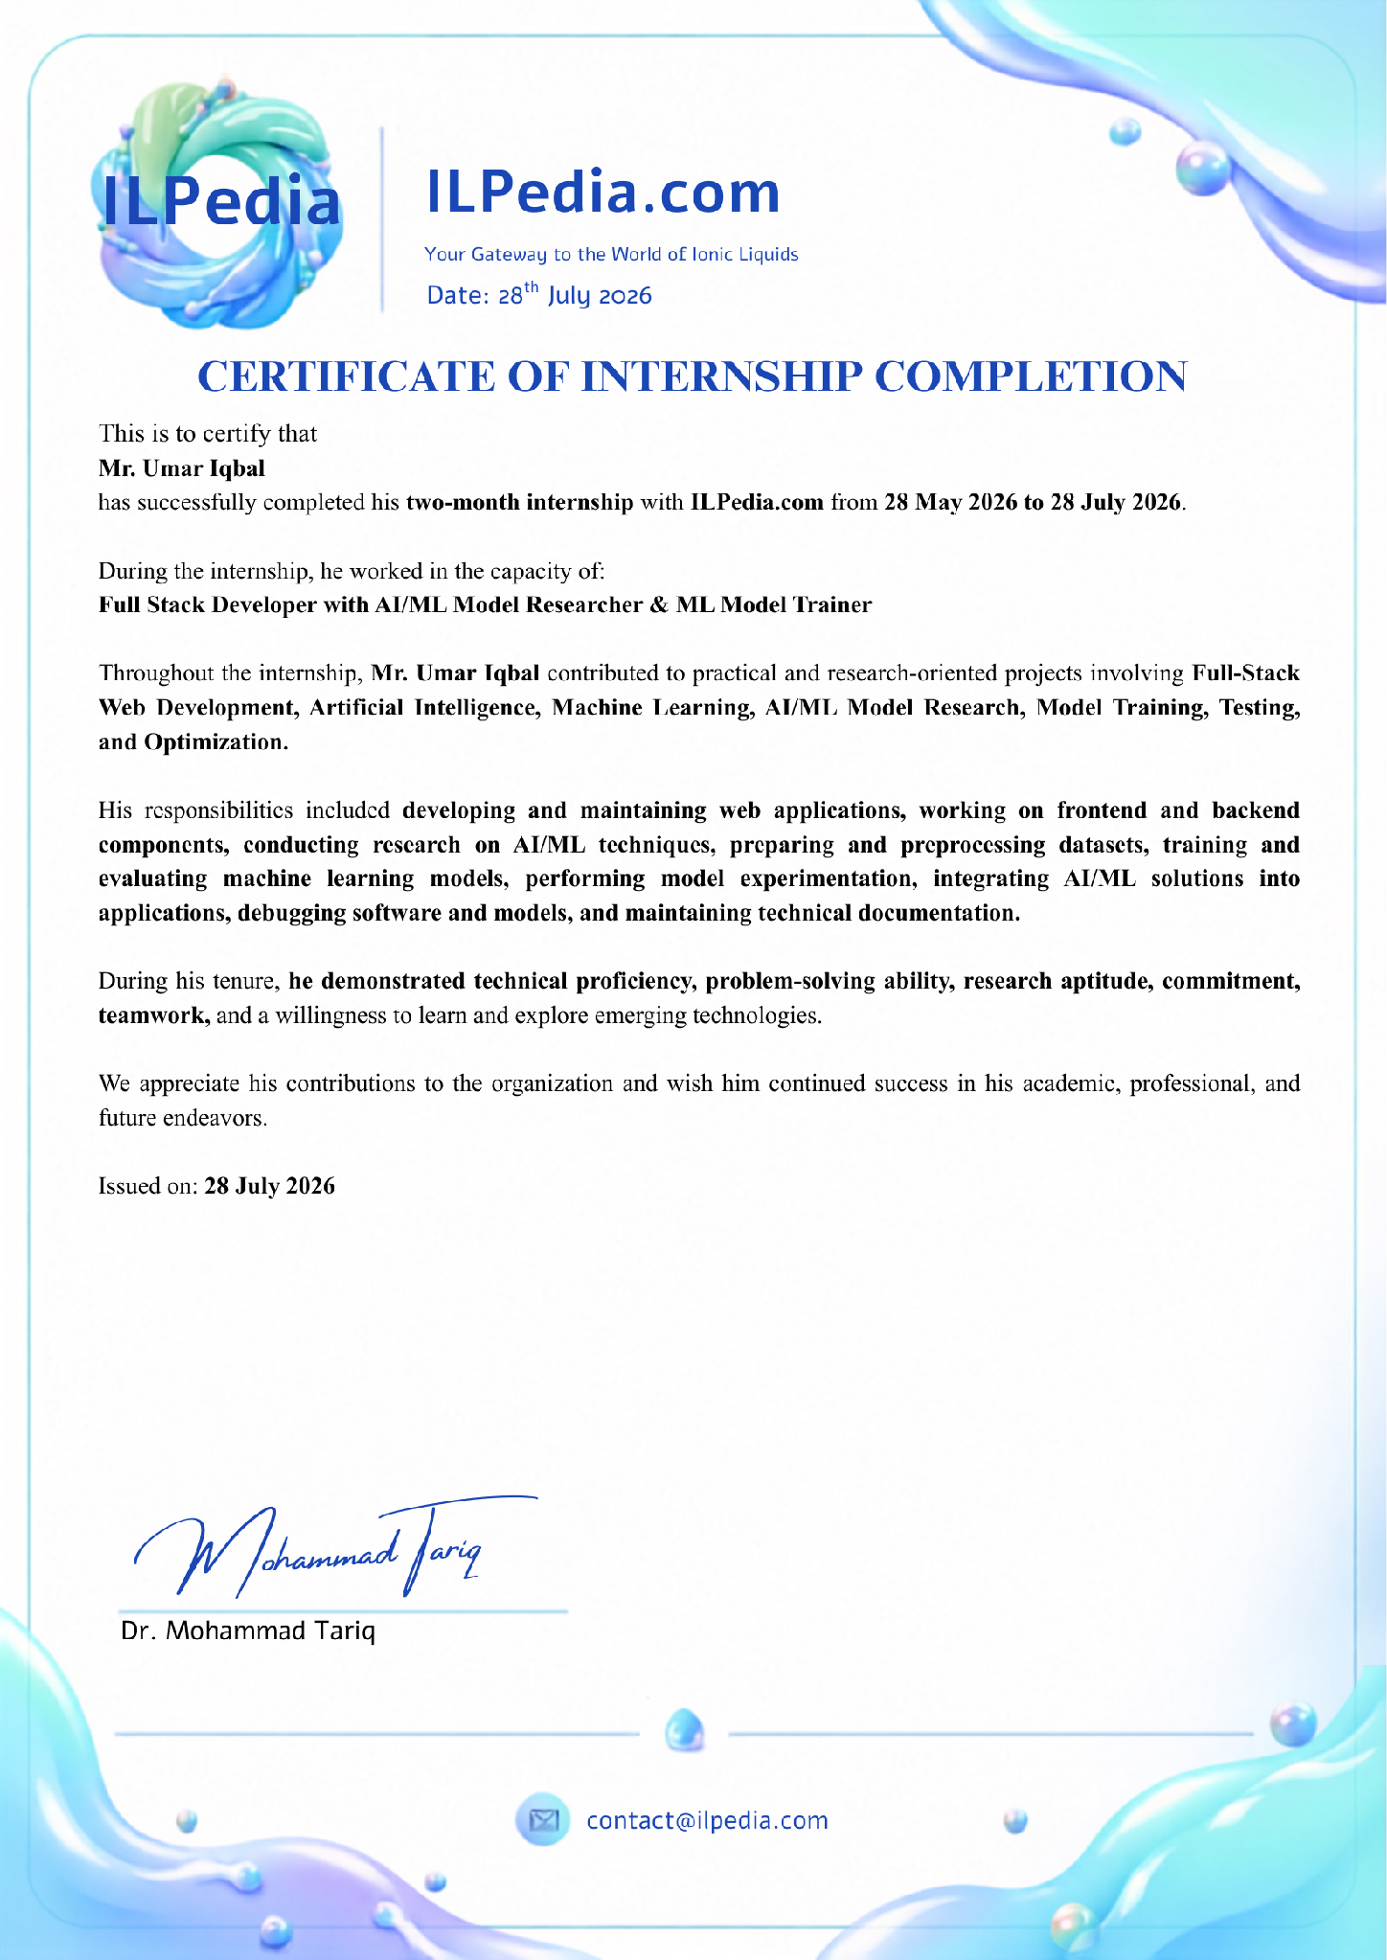

Certification of Completion
Issued by ILPedia.com
Signed by Dr. Mohammad Tariq • Issued 28 July 2026
Certificate of Internship Completion
Letter of Appointment (28 May 2026)
Letter of Internship Completion & Experience
11

Slide 12
Thank You
Grateful to ILPedia.com and Dr. Mohammad Tariq for the mentorship and opportunity.
Umar Iqbal
B.Tech CSE (Data Science & Big Data Analytics) | Roll No. 2410030933 | Section 3CSE12

